Slide 1

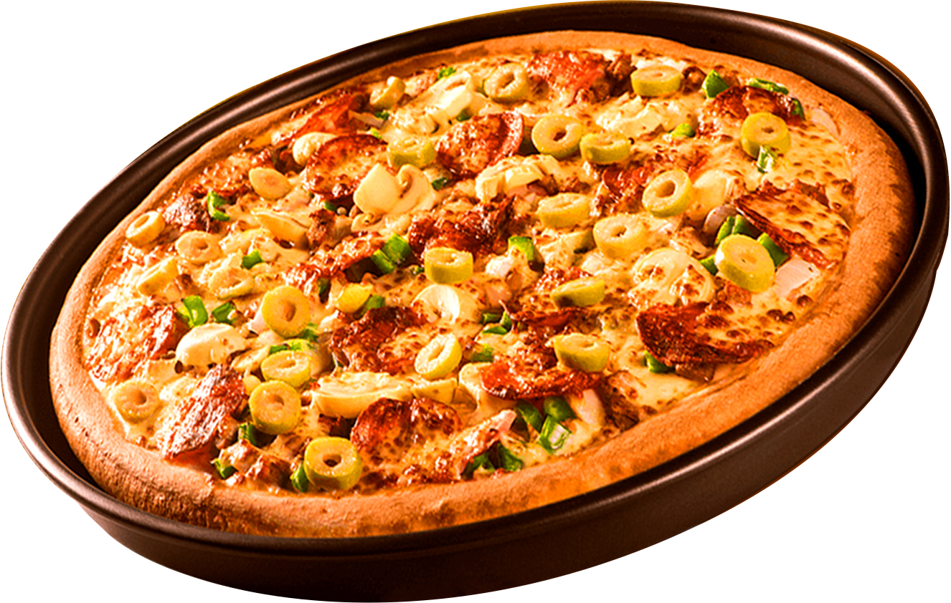
PIZZA SALES ANALYSIS USING MYSQL
ORDER
NOW

Slide 2

INTRODUTION
PIZZA SALES - PROJECT
Hello,
I’m Sibha Patait. I have created a Pizza Sales Analysis Project using MySQL.
In this project, I used a pizza sales dataset to write SQL queries and analyze business performance. The analysis focused on understanding sales trends, identifying top-performing pizzas, peak order times, and customer buying behavior.
This project helped me strengthen my MySQL skills and gain insights into real-world data analysis.

Slide 3
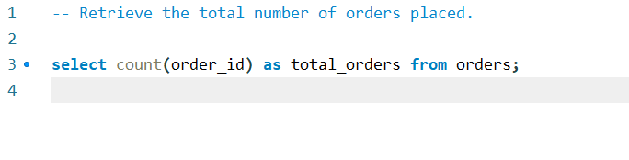

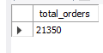

Retrieve the total number of orders placed.
OUTPUT

Slide 4
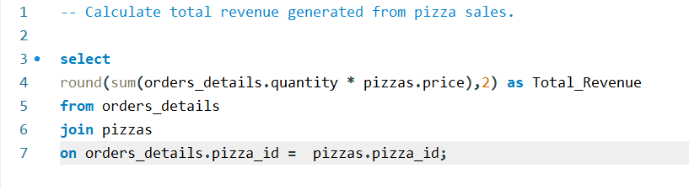
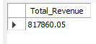
Calculate total revenue generated from pizza sales.
OUTPUT

Slide 5
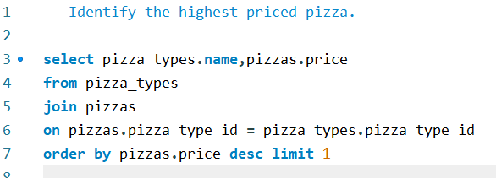
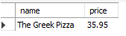
Identify the highest-priced pizza.
OUTPUT

Slide 6
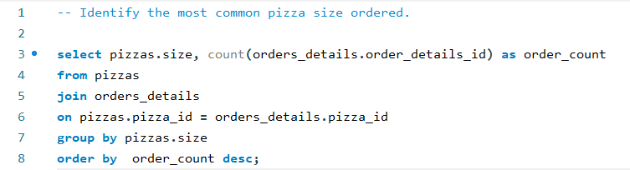
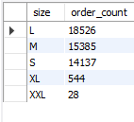
Identify the most common pizza size ordered.
OUTPUT

Slide 7
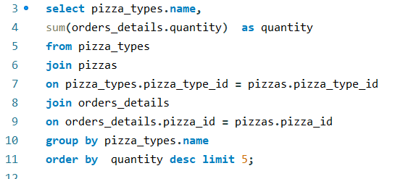
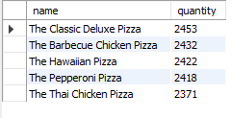
List the top 5 most ordered pizza types along with their quantities.
OUTPUT

Slide 8
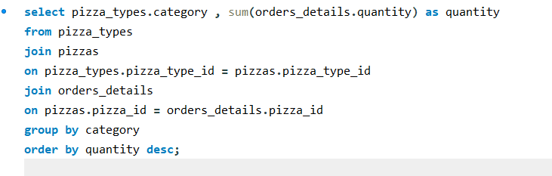
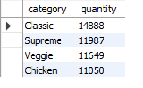
Join the necessary tables to find the total quantity of each pizza category.
OUTPUT

Slide 9
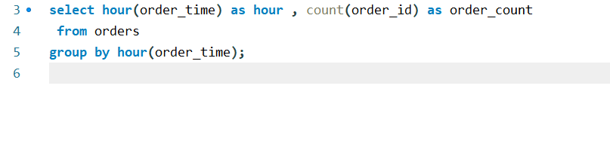
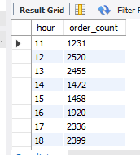
Determine the distribution of orders by hour of the day.
OUTPUT

Slide 10
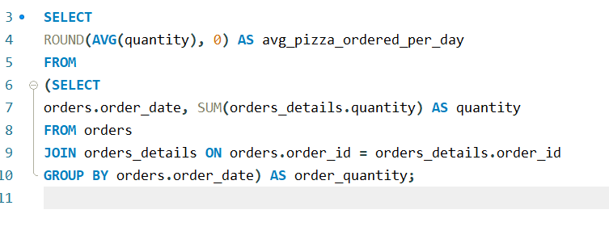
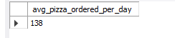
Group the orders by date and calculate the average number of pizzas ordered per day.
OUTPUT

Slide 11
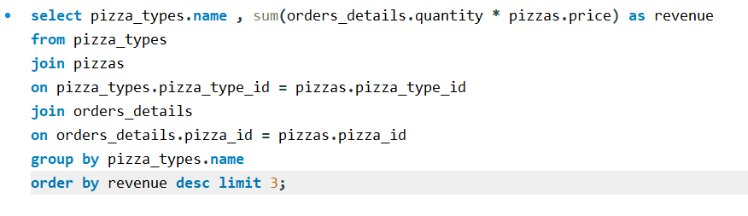
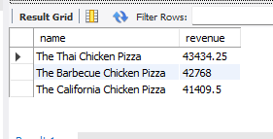
Determine the top 3 most ordered pizza types based on revenue.
OUTPUT

Slide 12
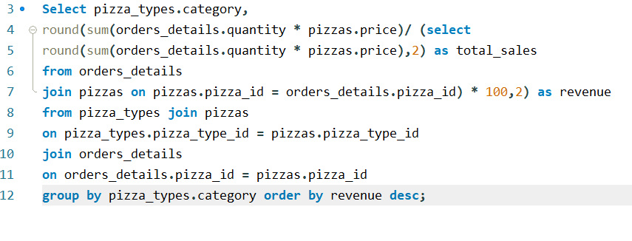
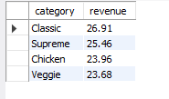
Calculate the percentage contribution of each pizza type of total revenue.
OUTPUT

Slide 13
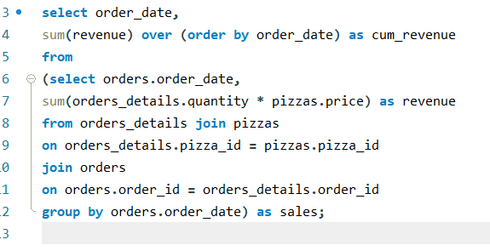
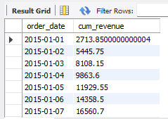
Analyze the cumulative revenue generated over time.
OUTPUT

Slide 14
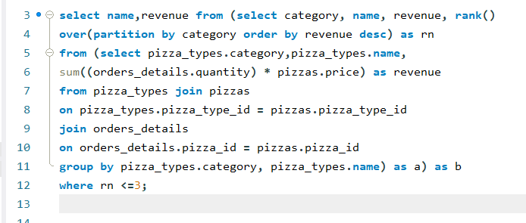
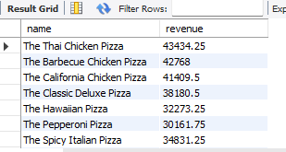
Determine the top 3 most ordered pizza types based on revenue for each pizza types.
OUTPUT

Slide 15
THANK YOU
FOR ATTENTION

